Slide 1


Marketing Strategies for Early-Stage Startups
AURORA DEEMED TO BE
UNIVERSITY
DEPARTMENT OF CSE – DS II YEAR I TERM AURORA HIGHER EDUCATION AND RESEARCH ACADEMY
Presented By: M. Sai Vardhan Reddy – 241U1R3001 G. Manasa – 241U1R3007 M. Naveen – 241U1R3004
Course Instructor: Meghana Bandi AURORA DEEMED TO BE UNIVERSITY

Slide 2

Introduction
Startups face high risk but also high opportunity.
Marketing gives direction by helping startups find customers and grow faster.
Smart marketing does not always need big money; it needs creativity and planning.
Many startups like OYO Rooms and Byju’s used low-cost marketing at the beginning to attract their first customers.

Slide 3
Why Marketing is Important for Startups
Builds brand identity → Customers remember the name.
Attracts first set of customers → Converts ideas into sales.
Creates trust → Customers believe in the product.
Helps compete with big companies → Position in the market.
Supports long-term growth → Continuous customer flow.
Flipkart built its brand identity by focusing on trust (Cash on Delivery).

Slide 4
Challenges Faced by Startups in Marketing
Limited budget and fewer resources.
Difficult to reach the right target audience.
Tough competition from big brands.
Less customer awareness about new product.
Marketing efforts must show quick results.
A new food delivery startup may struggle to compete with Swiggy and Zomato without a unique strategy.

Slide 5
Key Elements of Startup Marketing
Identify Target Audience → Who will buy?
Create Unique Value Proposition (USP) → Why should they buy?
Build a Brand Identity → Logo, message, values.
Choose Marketing Channels → Online/offline methods.
Track and Measure Results → Improve regularly.
Tesla created USP as “sustainable luxury cars,” which made them stand out.

Slide 6

Low-Cost Marketing Strategies
Use free social media platforms.
Create blogs, videos, and podcasts.
Build community groups (WhatsApp, Telegram).
Collaborate with other startups.
Attend local events.
Mamaearth grew quickly by using social media ads and parenting blogs instead of expensive TV ads.

Slide 7

Social Media Marketing
Use Instagram, Facebook, LinkedIn, Twitter for updates.
Post product features, customer stories, short videos.
Use hashtags, polls, Q&A for engagement.
Build a loyal customer community.
Zomato became popular using funny Twitter and Instagram posts.

Slide 8
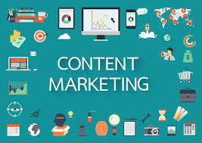
Content Marketing
Write helpful blogs, tutorials, and guides.
Share videos, infographics, and e-books.
Educate customers instead of only selling.
Improve visibility through SEO.
Byju’s built trust by giving free learning videos to students before selling full courses.

Slide 9

Influencer & Referral Marketing
Work with small influencers who connect with audience.
Offer free product trials to influencers.
Ask satisfied customers to refer friends.
Give rewards (discounts, coupons) for referrals.
Paytm and PhonePe gave cashback for referrals to grow their customer base.

Slide 10

Events and Networking
Attend local startup events and pitch competitions.
Join online forums and startup communities.
Build partnerships with other businesses.
Increase visibility with word-of-mouth.
Ola started by networking at college fests and startup events to get attention.

Slide 11
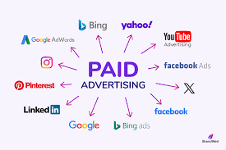
Paid Advertising (Smart Use)
Use Google Ads and Facebook Ads with small budget.
Target specific locations, age groups, and interests.
Start small, test, then increase budget.
Avoid wasting money on wrong audience.
A new café can target ads only to people nearby using Google Maps ads.

Slide 12
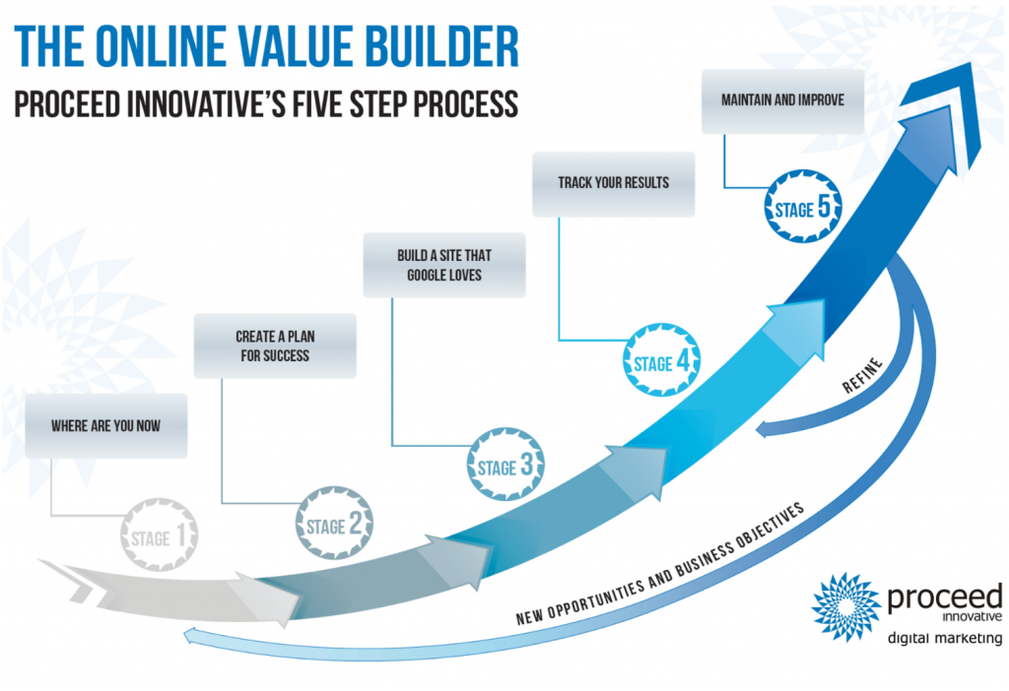
Measuring Marketing Success
Track customer visits, clicks, and conversions.
Use free tools like Google Analytics.
Monitor customer feedback and reviews.
Improve campaigns using data.
Startups like Swiggy track which ads bring the most orders and adjust strategy.

Slide 13
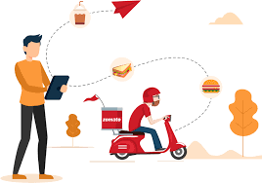
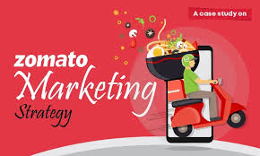
Case Example – Zomato
Began as a restaurant review site with blogs.
Used social media posts to attract food lovers.
Offered discounts and referral programs.
Built a large base of loyal users quickly.
Other food startups can learn from Zomato’s “content first, product later” approach.

Slide 14
Conclusion
Marketing is the lifeline for startups.
Focus on low-cost but high-impact strategies.
Build strong customer relationships.
Always measure results and adapt.
With the right marketing, startups can compete with big brands.
A startup with smart marketing can grow like OYO, Swiggy, or Mamaearth, which began small but became household names.

Slide 15


